Slide 1
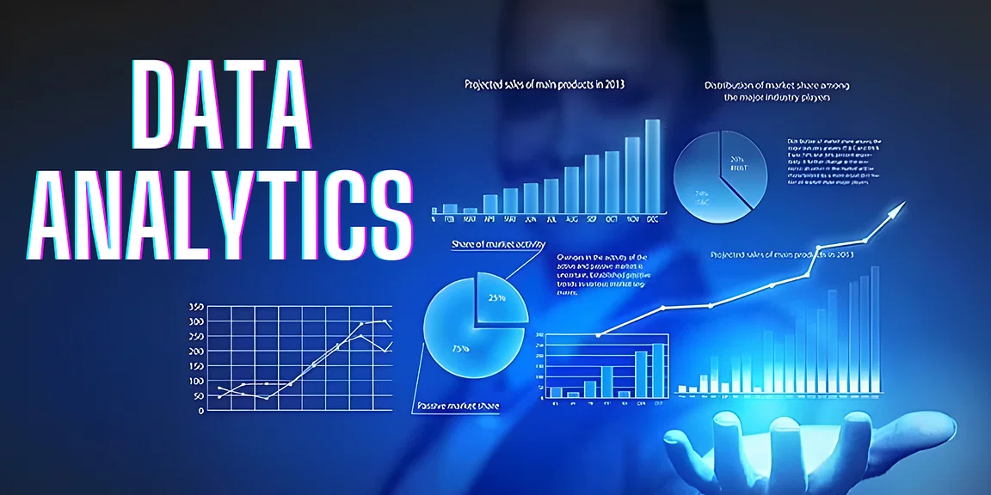

Slide 2
What is Data?
Data is a different types of information formatted in a particular manner or Data is a collection of information present in the form of History, Past records or Present records.
Data can come in the form of text, picture, numbers, graphs and symbols.
What is Data Analytics?
Data Analytics is the process of collection, transformation and organizing the data in order to draw conclusions, make predictions and to boost data driven decision making.

Slide 3
Applications of Data Analytics
Data Analytics is used in the banking and e-commerce industries to detect fraudulent transactions.
The Healthcare sectors uses data analytics to improve patients health by detecting diseases before they happen. It is commonly used for cancer detection.
Logistics companies use data analytics to ensure faster delivery of products by optimizing vehicle routes.
Marketing professionals use analytics to reach out to the right customers and perform targeted marketing to increase ROI.
Data analytics can be used for city planning, to build smart cities.

Slide 4
Vrinda Store Sales Data Analysis
Let me Explain how data analyst works in a real-world industry by taking example of Vrinda Store Sales Sales Data Analysis Project.
Steps Followed in Data analysis Process
Problem statement
Data Collection
Data Cleaning
EDA process
Creating Dashboard
Conclusion

Slide 5
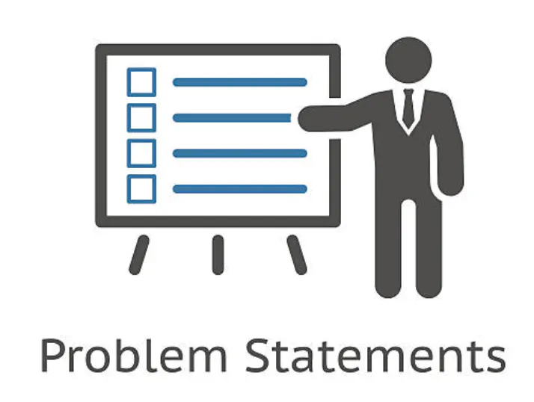
Step 1: Problem Statement
Vrinda store wants to create an annual sales report for 2022. So that, Vrinda
can understand their customers and grow more sales in 2023.

Slide 6
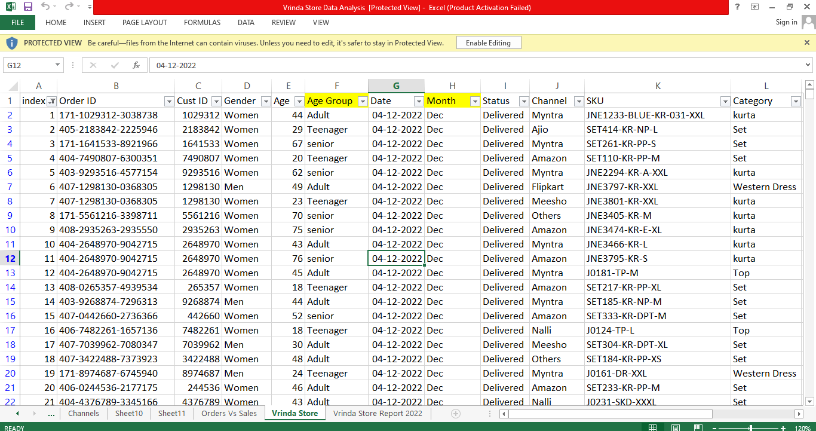
Step 2: Data Collection
Data Format: SalesData.xlsx
Data Size: 4.8+ MB
Collection of measurements:
Total No. of Columns: 21
Total No. of Rows: 31047
Column Names:
Numerical Data/Columns: ‘index’, ‘Cust ID’, ‘Age’, ‘Qty’, ‘Amount’, ‘ship-postal-code’.
Categorical Data/Columns: Order ID,Gender,Age Group,Date,Month,Status,Channel,SKU, Category
, Size,currency,ship-city,ship-state,ship-country’.

Slide 7
Step 3: Data Cleaning
Data cleaning process is done by using ETL (Extract, Transform, Load) technique.
Extract: Extract the data from file in csv, sql format of file.
Transform: Transform is nothing but modify or change the data. In this step we clean all the data, to find missing values and filled them using python libraries. So new values are added to the existed raw data and to make it clean.
Load: Load or upload the cleaned data into database.
Data is transformed (cleaned) in Excel editor.

Slide 8
Step 4: EDA ( Exploratory Data Analysis)
EDA technique is used to analyze cleaned data to draw informative insights.
Compare the sales and orders using single chart
which month got the highest sales and orders?
What are different order status in 2022?
List top 10states contributing to the sales?
Relation between age andgender based on number orders?
Which channel is contributing to maximum sales?
Highest selling category?

Slide 9
Women are more likely to buy compared to men (65%).
Maharashtra, Karnataka and Uttar Pradeshare the top 3.
Adult age group (30-49 yrs) is max contributing (50%).
Amazon, Flipkart and Myntra channels are max contributing.

Slide 10
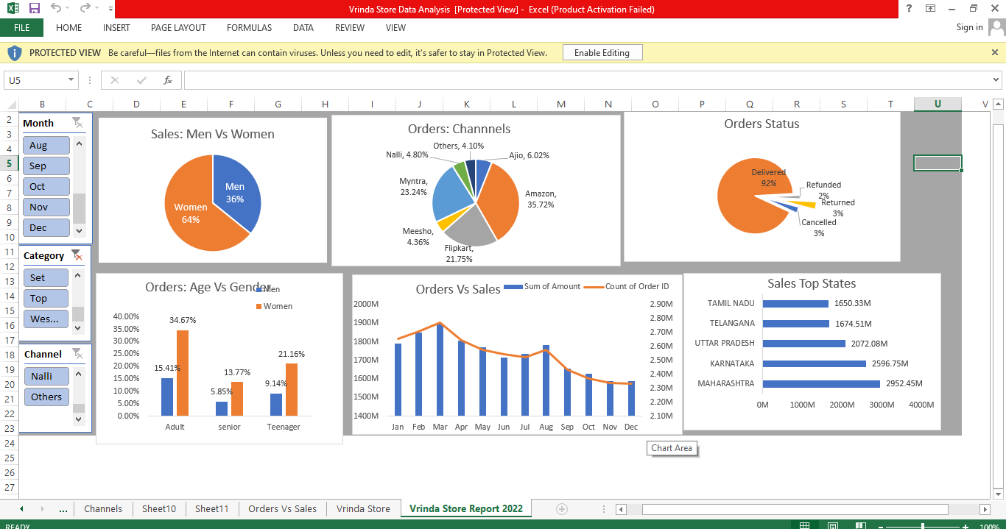

Slide 11
Conclusion:
Target women customers of age group (30-49 yrs) living in Maharashtra, Karnataka and Uttar Pradesh by showing ads/offers/coupons available on Amazon, Flipkart and Myntra.

Slide 13
Conclusion:
Target women customers of age group (30-49 yrs) living in Maharashtra, Karnataka and Uttar Pradesh by showing ads/offers/coupons available on Amazon, Flipkart and Myntra.

